Slide 1
Weapon Detection in Real-Time CCTV Videos Using Deep Learning
Batch No : 4
Battina Nandini(Y19CS003)
Choday Swetha(Y19CS024)
Chittemsetty Roopa Devi(Y19CS023)
Guided by
Dr. R. Lakshmi Tulasi Mam
Incharge:
Dr. B. Vara Prasad Rao Sir

Slide 2
Problem Statement
In this project, we tackle the problem of detecting the presence of weapons within an image.
We want to learn a function that given an image as input returns the presence and the location of the weapon.
Weapon detection presents some peculiar and significant challenges.
The work focuses on providing a secure place using CCTV footage as a source to detect harmful weapons by applying the state of the art open-source deep learning algorithms.

Slide 3
Abstract
Security and safety is a big concern for today’s modern world.
CCTV cameras are being used for surveillance and to monitor activities.
We need a system that can automatically detect these illegal activities.
We have implemented binary classification assuming pistol class as the reference class and relevant confusion objects inclusion concept is introduced to reduce false positives and false negatives.
Two approaches are used i.e. sliding window/classification and region proposal/object detection.

Slide 4
Requirements
Software Requirements:
Operating system : Windows 10 and above
Language Requirement : Python
Hardware requirements:
Processor: i5 processor based computer
Good Internet Connectivity
Memory: 1GB
Hard Drive : 50GB

Slide 5
Dataset
To train all those algorithms there is no public dataset available so author of this paper is creating his own dataset from CCTV images. So we have downloaded few KNIVES and GUNS images from Google to train algorithms.
The dataset include:
Knife
Guns

Slide 6
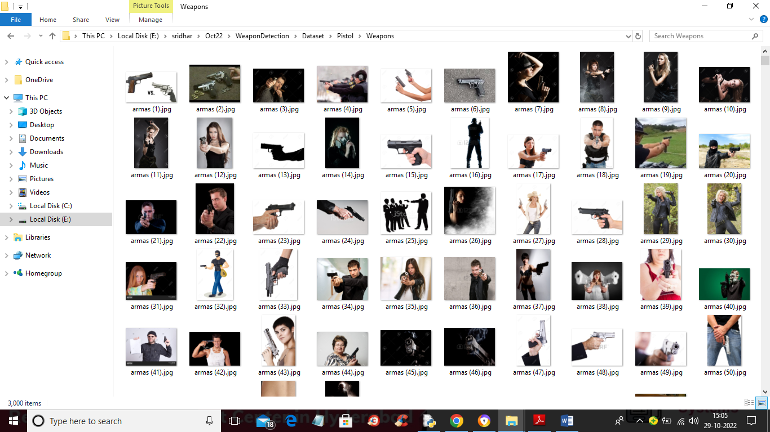

Slide 7
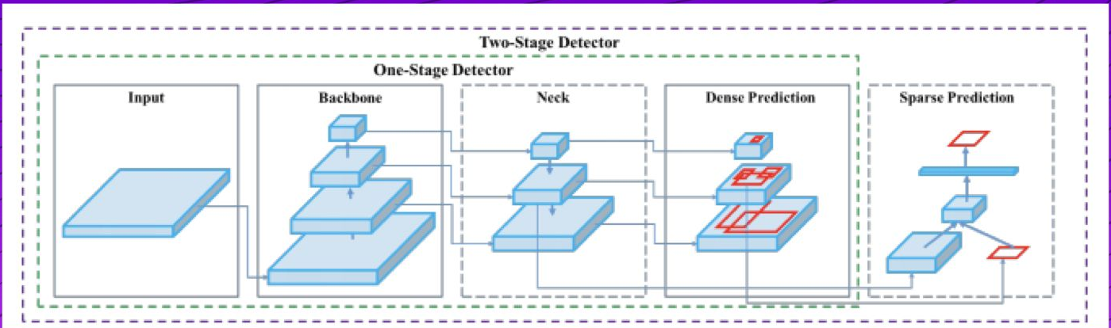
Algorithm
YOLOV4:
YOLOv4 prioritizes real-time object detection and training takes place on a single CPU.
There are two types of models, one and two-staged object detectors.

Slide 8
MODULES
To implement this project we have designed following modules:
Upload Weapon Dataset: using this module we will upload dataset to application
Load Yolov4 Weapon Detection Model: this will read dataset images and then trained or load Yolov4 model and then calculate its prediction accuracy
Upload Image: using this module we will upload test image
Detect Weapon from Image: using this module we will apply Yolov4 model on loaded image to detect weapon
Detect Weapon from Video: using this module we will upload video and then YoloV4 will analyse each frame in the video to detect weapon
Weapon Detection Training Accuracy-Loss Graph: using this module we will plot YoloV4 training accuracy and loss graph

Slide 9
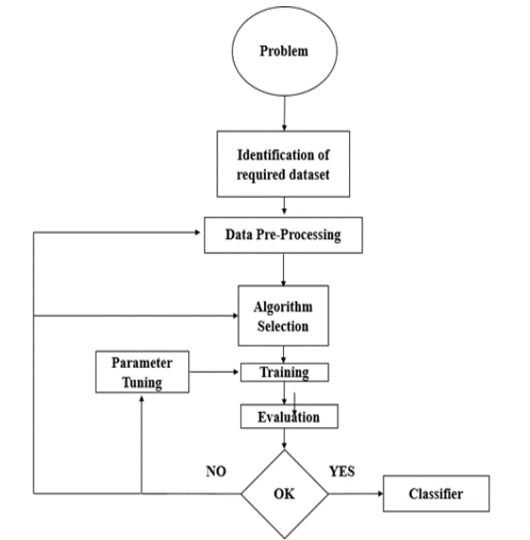
SYSTEM ARCHITECTURE

Slide 10
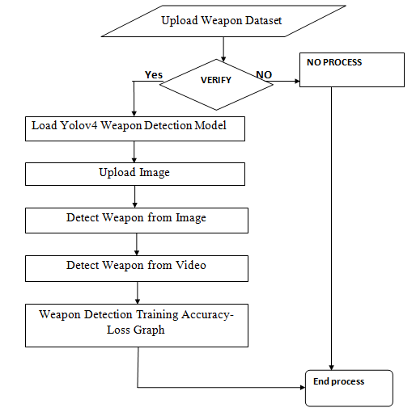
DATAFLOW DIAGRAM

Slide 11
USECASE DIAGRAM

Slide 12
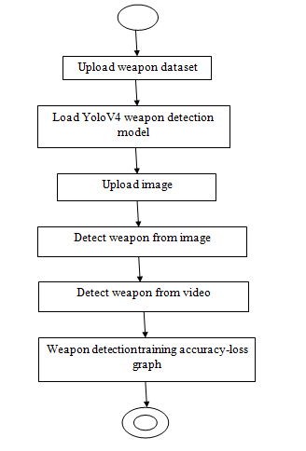
ACTIVITYDIAGRAM

Slide 13
SEQUENCE DIAGRAM

Slide 14
COLLABORATION DIAGRAM

Slide 15
CLASS DIAGRAM

Slide 16
COMPONENT DIAGRAM

Slide 17
DATAFLOW DIAGRAM

Slide 18
Results

Slide 19
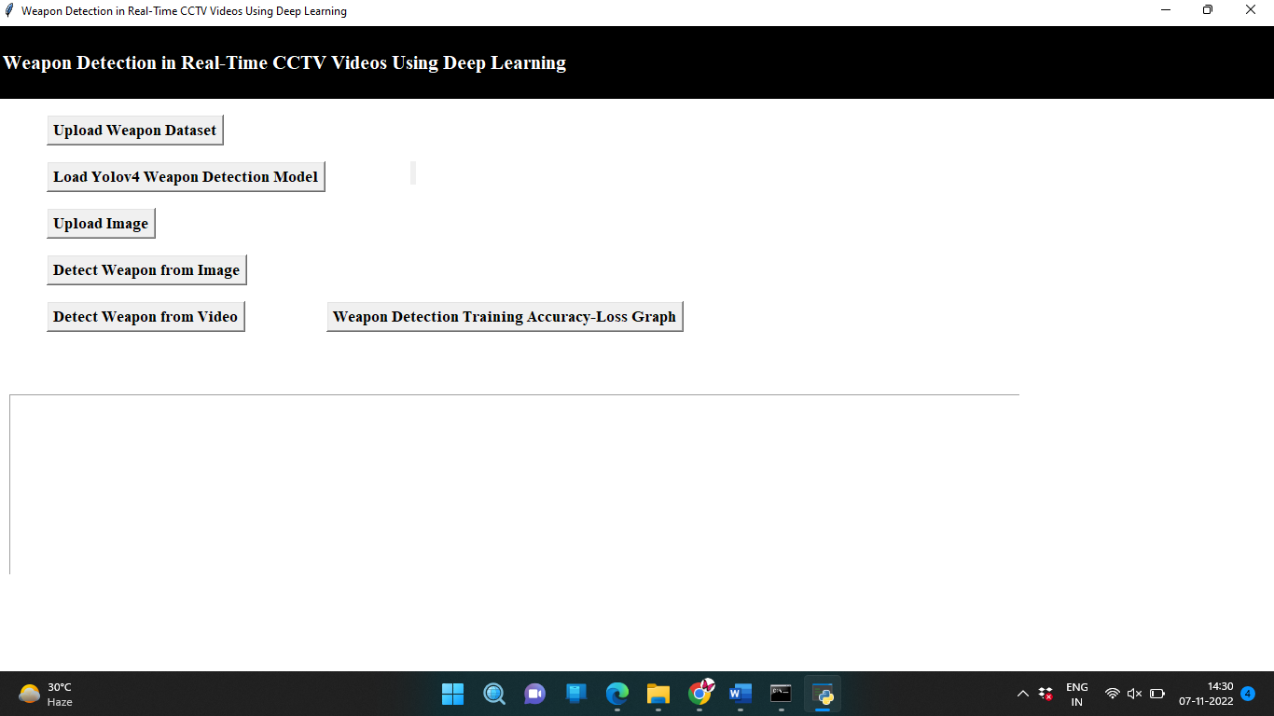

Slide 20
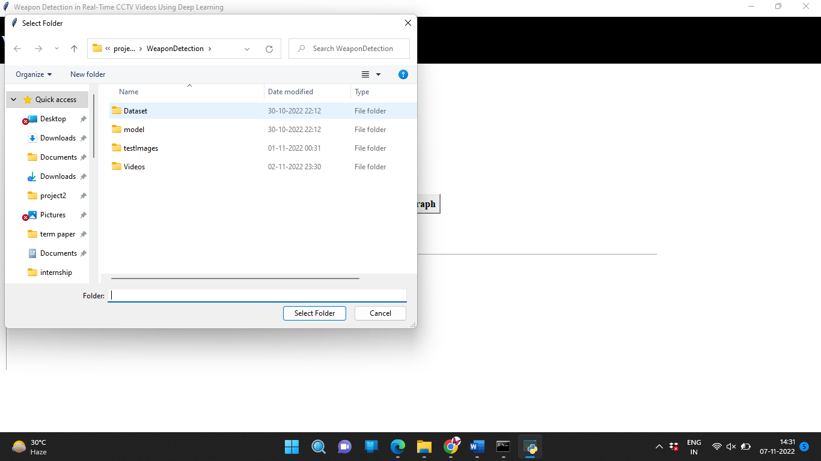

Slide 21
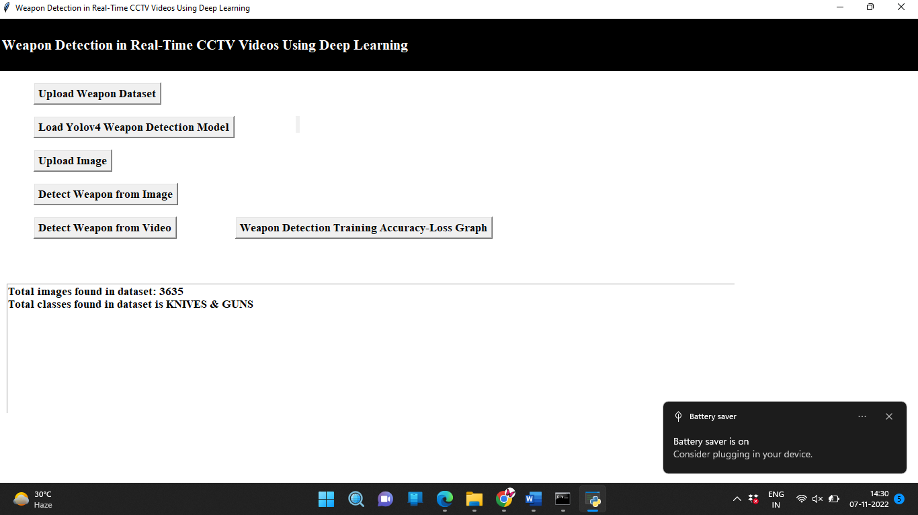

Slide 22
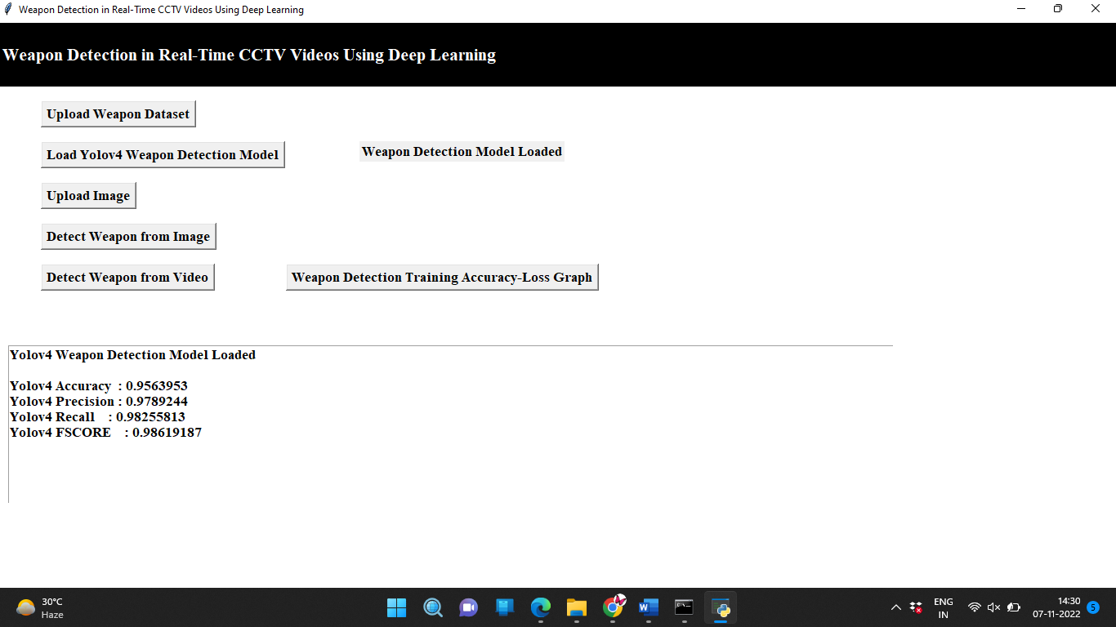

Slide 23
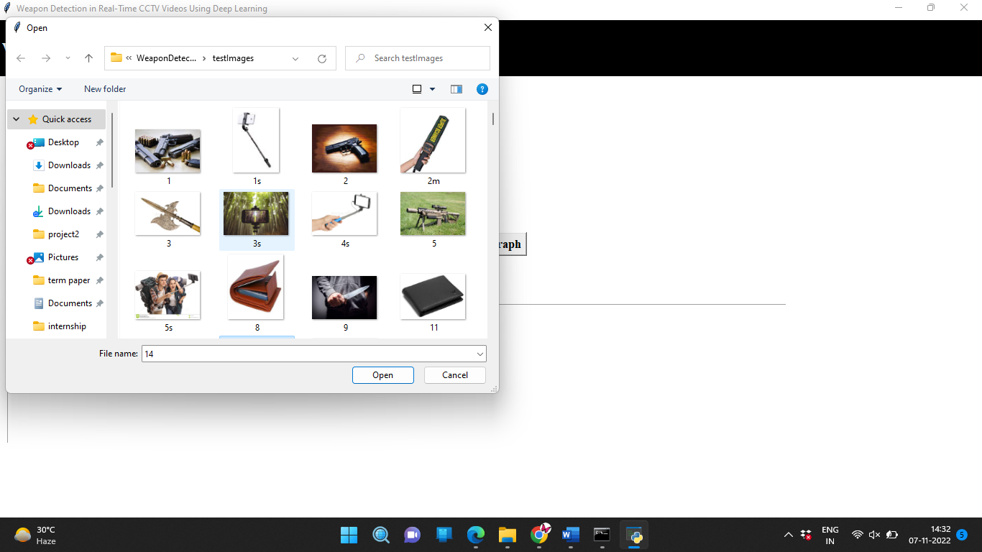

Slide 24
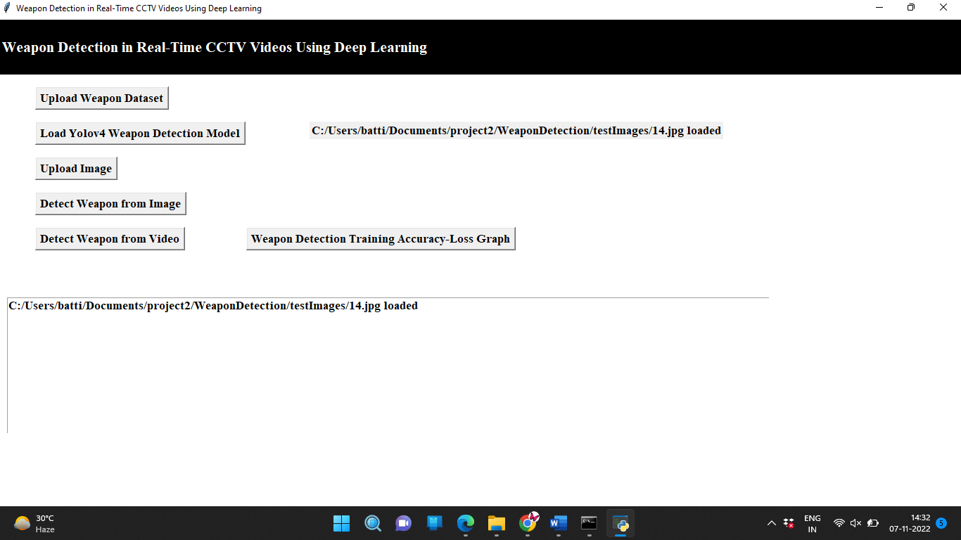

Slide 25
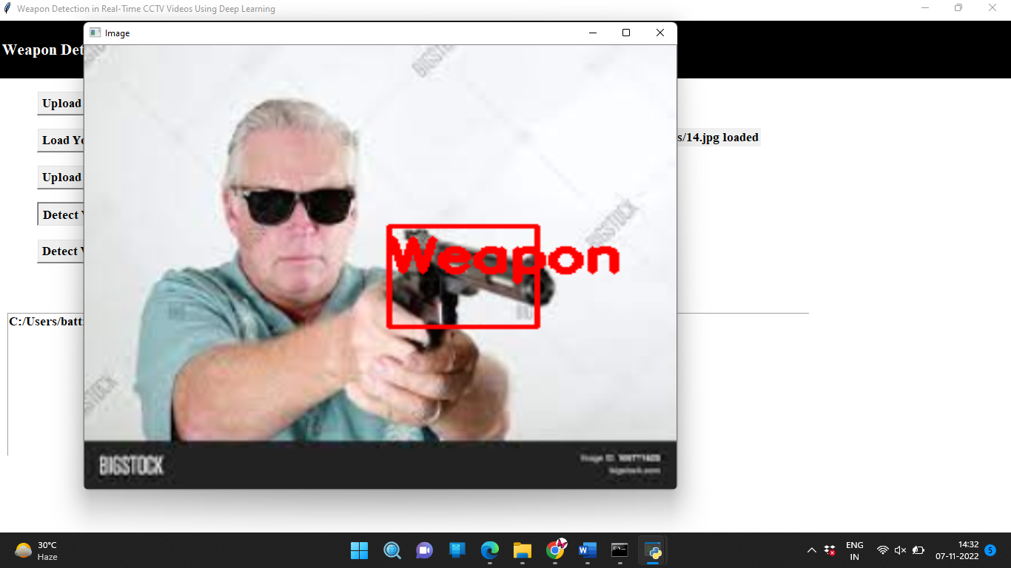

Slide 26
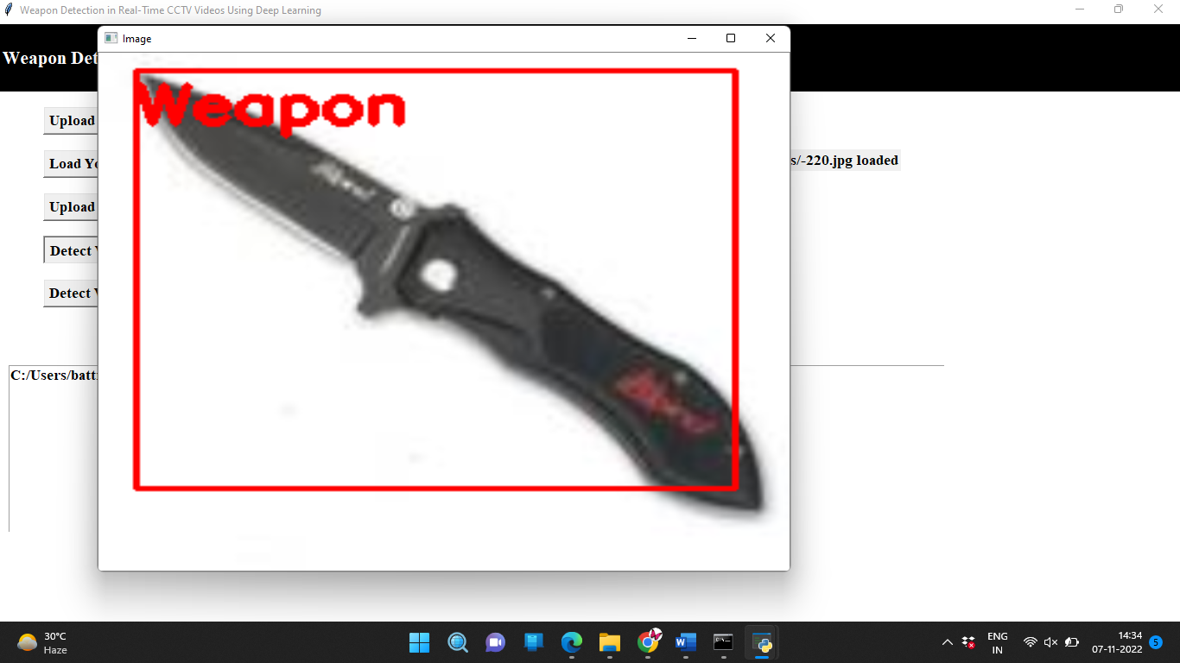

Slide 27
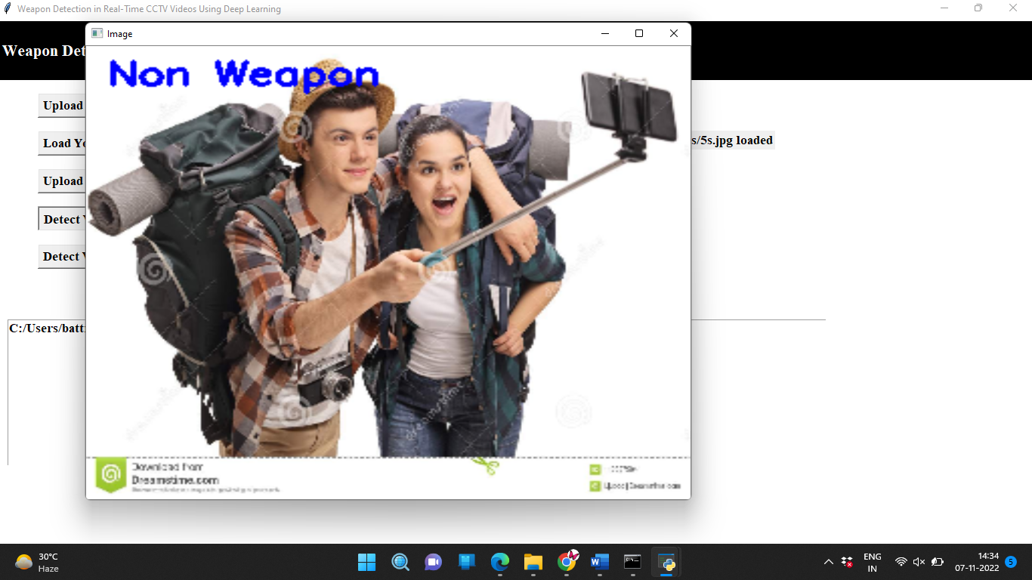

Slide 28
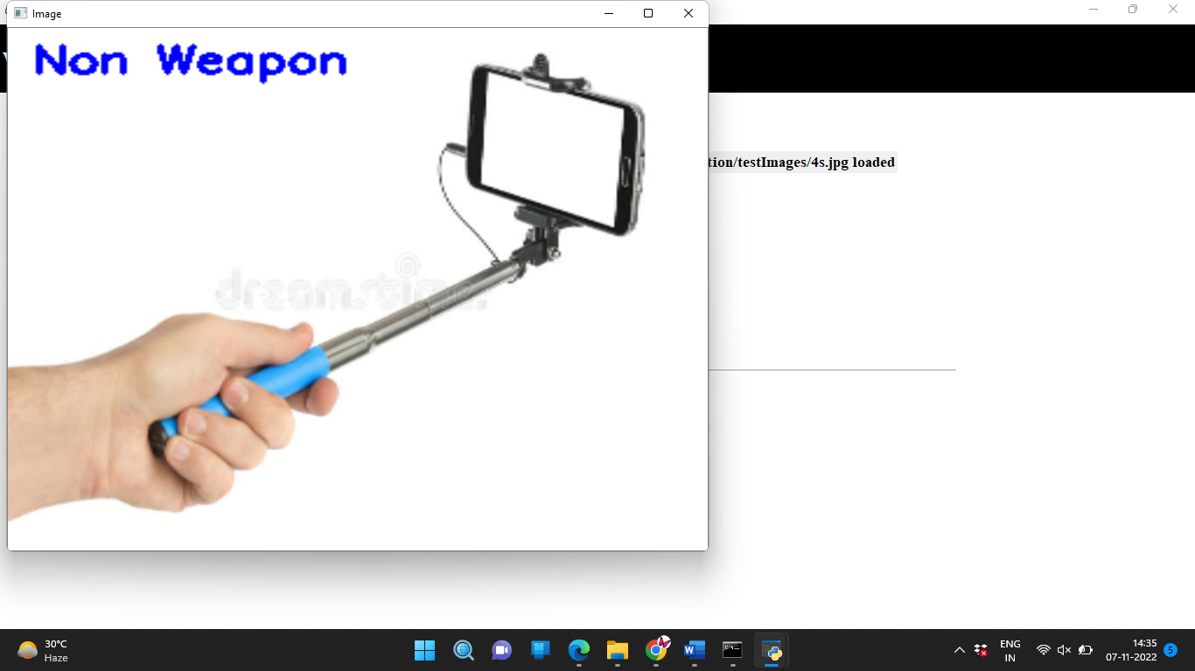

Slide 29
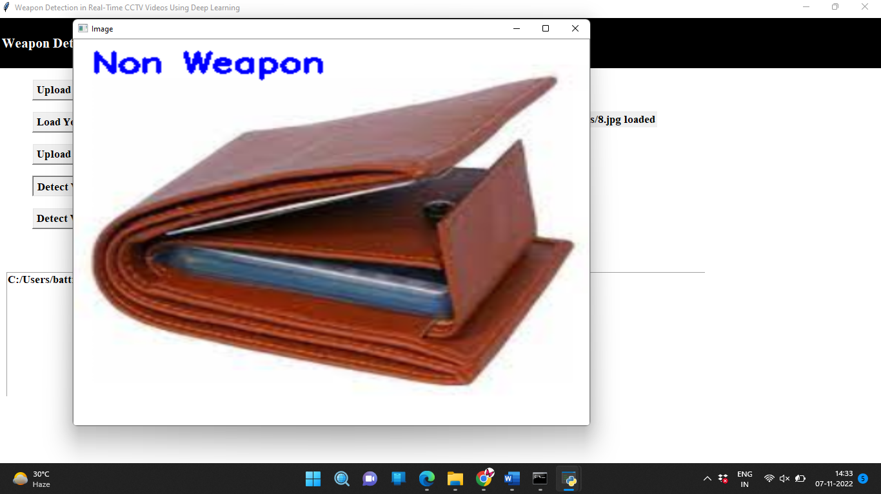

Slide 30
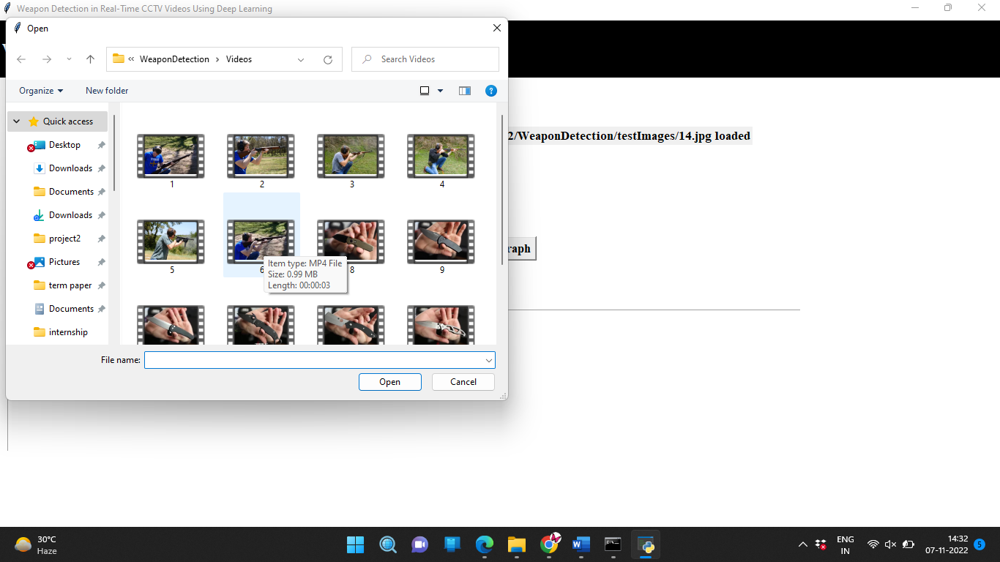

Slide 31
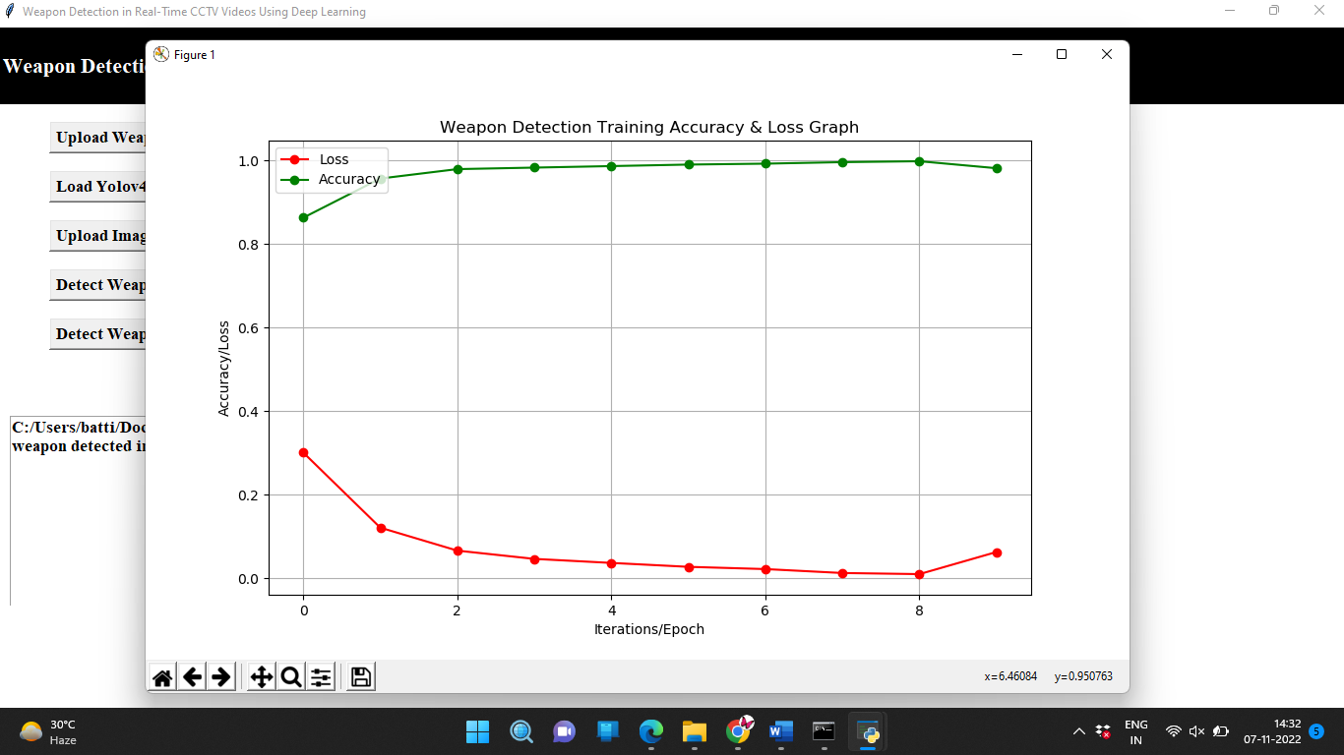

Slide 32
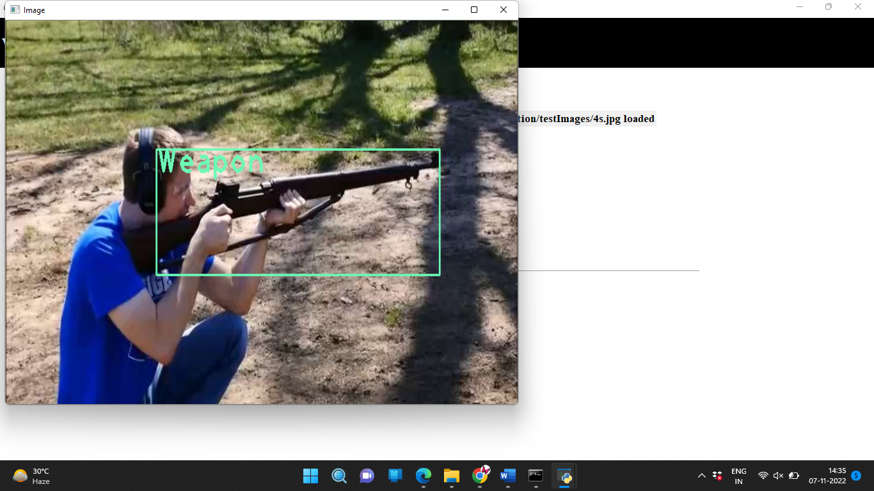

Slide 33
Thank You

